Slide 1
RC Circuits Integrators and Differentiators

Slide 2
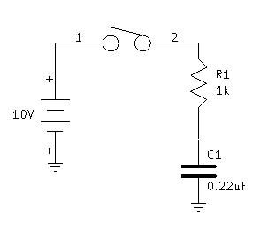
RC Circuits
Time Constant and Capacitor Charging
With the switch open:
V_{c}= 0
V_{R} = 0
If the charge on C₁ is zero at the instant the switch is closed(t₀), the current in the circuit is given as:
This 10mA current causes the capacitor to charge.

Slide 3
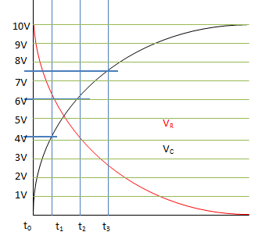
Capacitor Charge
At t₁ the capacitor is approximately 4V, and the resistor is the difference of 10V – Vc = 6V.
At t₂ the capacitor is approximately 6V, and the resistor is the difference of 10V – Vc = 4V.
At t₃ the capacitor is approximately 7.5V, and the resistor is the difference of 10V – Vc = 2.5V.

Slide 4
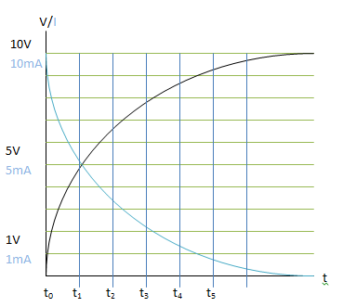
Current
The current in the circuit for each point in time is given:
For t₁ :
V_{c} = 5V
The current in the circuit is:
This shows that as the voltage across the capacitor increases, the current through the circuit decreases.

Slide 5
Time Constant
The relationship to the capacitor charge and the current in the circuit is directly related to the resistance in the circuit and the capacitor value. This is the time constant of the circuit ( )
The capacitor voltage follows the equation:
Where:
V_{c} = Capacitor Voltage
V_{f} = Capacitor max voltage
V_{ini} = Capacitor initial voltage
E = Asymptotic constant
t= time allowed to charge
= time constant of the circuit.

Slide 6
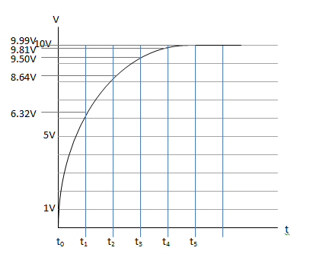
Time Constant
When C = 0.22uF
And R = 1k
From the equation:
For each time(t_{0,}t_{1,}t_{2…}etc.) when t = 1RC we can plot the voltages for V_{c} after 1 time constant, 2 time constants… etc.
For instance at t₁:
And at t₂:

Slide 7
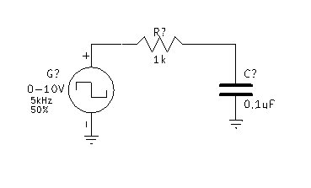
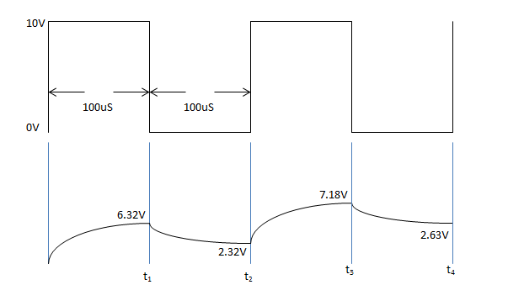
RC Circuit Response to Square Waves
So for t₁:

Slide 8
RC Circuit Response to Square Waves
Continue to graph the voltages for each time. For t₂ the capacitor now is discharging, and the initial voltage is the voltage the capacitor charged to during the charge cycle.
The cap continues to charge and discharge in this fashion so that after several intervals the capacitor’s max and min voltage will stabilize.
The cap will always charge to a specific voltage level and discharge to a specific voltage level.
t₂:
t₃:
t₄:

Slide 9
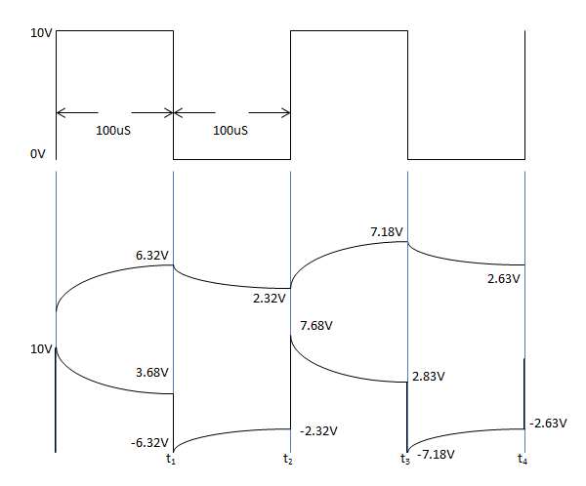
RC Circuit Response to Square Waves
Use Kirchoff’s voltage equation to solve for the resistor values at each point in time.
For t₁, at the end of the pulse width, Vgen = 10V and V_{C} = 6.32v so the resistor voltage V_{R}= 3.68V. Then Vgen falls to zero, and the capacitor discharges, making it the source voltage, so V_{R} = -V_{C}. As the capacitor discharges its voltage to 2.32V, the resistor sees the capacitor voltage.

Slide 10
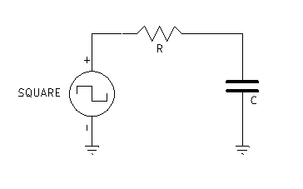
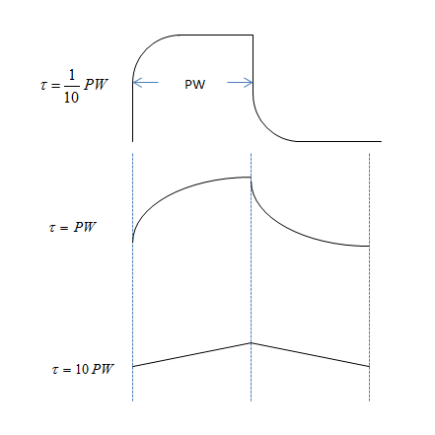
Integrating Circuits
In this circuit, the output is taken across the capacitor.
The shape of the output wave is dependent on the RC time constant, and the PW.
If the is much smaller than the PW the capacitor charges to 99.9% of the input voltage after time t=5RC.
If the is equal to the PW then the capacitor charges to 63.2% of the input voltage.
If the is much greater than the PW (10*PW) then an integrator is formed and V_{c} can be found by:

Slide 11
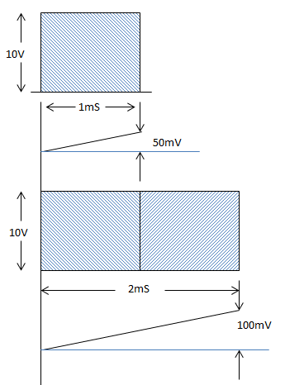
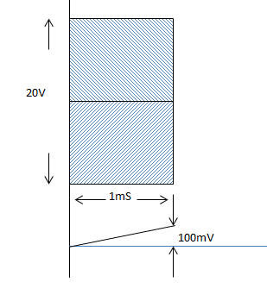
Integrating Circuits
An integrating circuit’s output is proportional to the area of the input pulse

Slide 12
Integrator
An RC integrator is a circuit that approximates the mathematical process of integration. Integration is a summation of area, and a basic integrator can produce an output that is a running sum of the input, or rather the output is the average voltage of the waveform.
R
A basic RC integrator circuit is simply a capacitor in series with a resistor and the source. The output is taken across the capacitor.
V_{S}
C
V_{out}

Slide 13
The RC Integrator
When a pulse generator is connected to the input of an RC integrator, the capacitor will charge and discharge in response to the pulses.
Switch closes
When the input pulse goes HIGH, the pulse generator acts like a battery in series with a switch and the capacitor charges.
R
C
The output is an exponentially rising curve.

Slide 14
The RC Integrator
When the pulse generator goes low, the small internal impedance of the generator makes it look like a closed switch has replaced the battery.
The pulse generator now acts like a closed switch and the capacitor discharges.
R
The output is an exponentially falling curve.
C

Slide 15
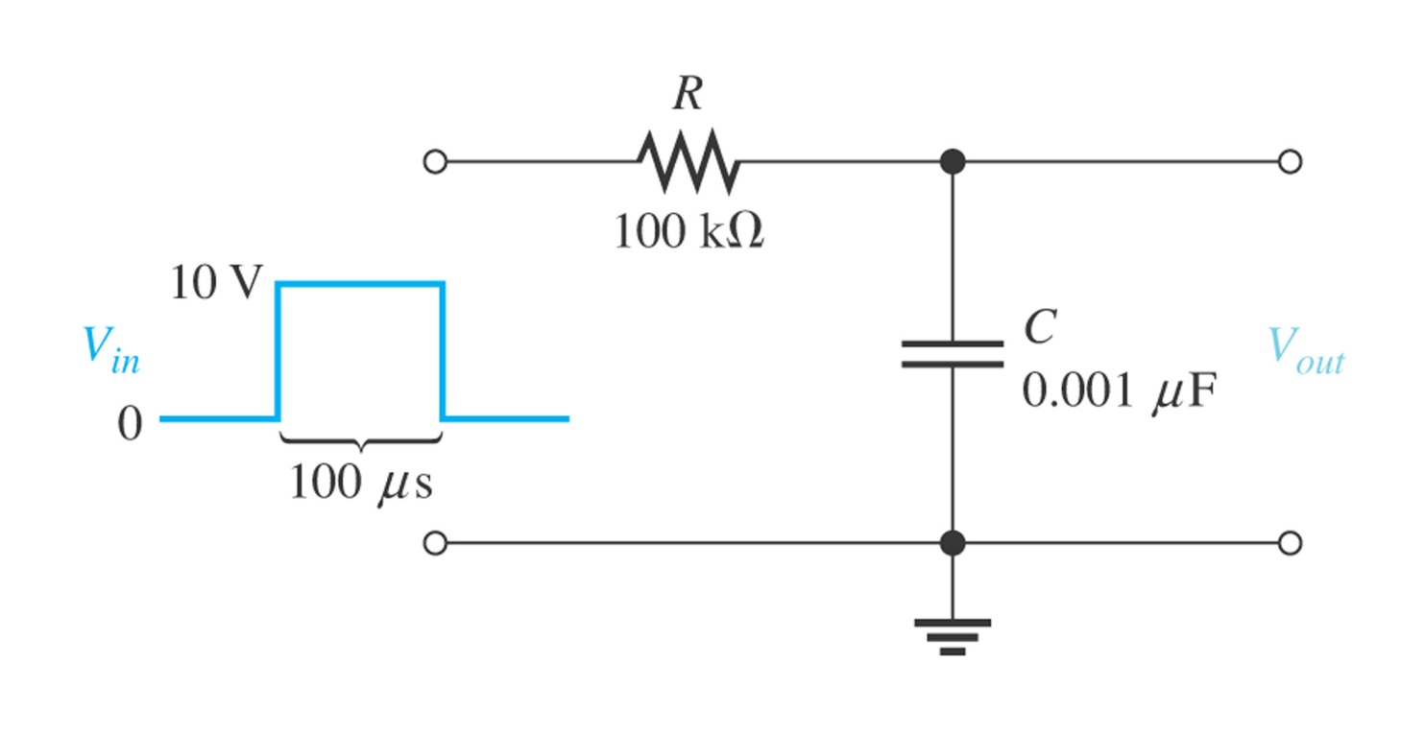
Examples

Slide 16
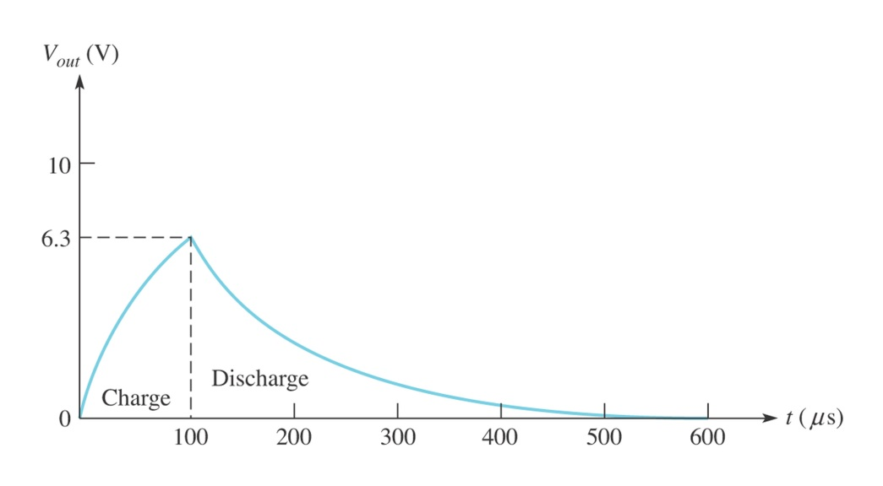
Solution
1. Time constant
2. Compute the Vout for one time constant
3. Time to finish discharging

Slide 17
The RC Integrator
Waveforms for the RC integrator depend on the time constant (t) of the circuit. If the time constant is short compared to the period of the input pulses, the capacitor will fully charge and discharge. For an RC circuit, = RC. The output will reach 63% of the final value in 1 .
R
C
The output will reach steady state in about 5t
What is τ if R = 10 kΩ and C = 0.022 μF?
220 μs

Slide 18
The RC Integrator
If t is increased, the waveforms approach the average dc level as in the last waveform. The output will appear triangular but with a smaller amplitude.
V_{in}
t
V_{out}
t
V_{out}
Alternatively, the input frequency can be increased (T shorter). The waveforms will again approach the average dc level of the input.
t
V_{out}
t

Slide 19
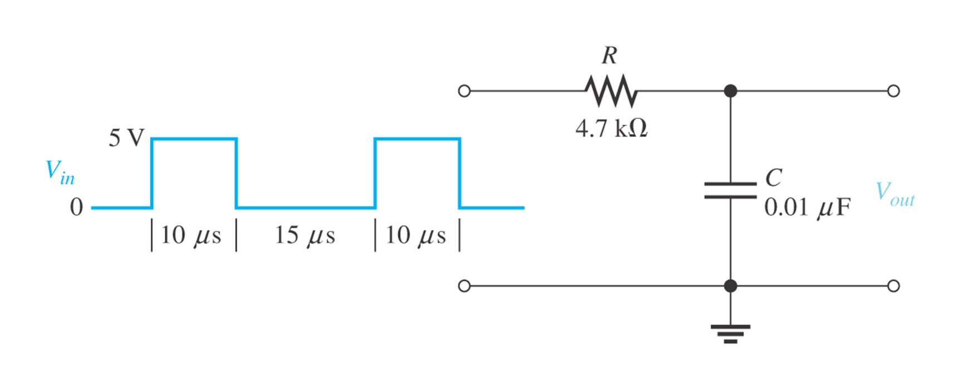
Example

Slide 20
Solution
1. Time constant
2. Calculate the first pulse
3. Calculate the second pulse
4. Calculate the second pulse

Slide 21
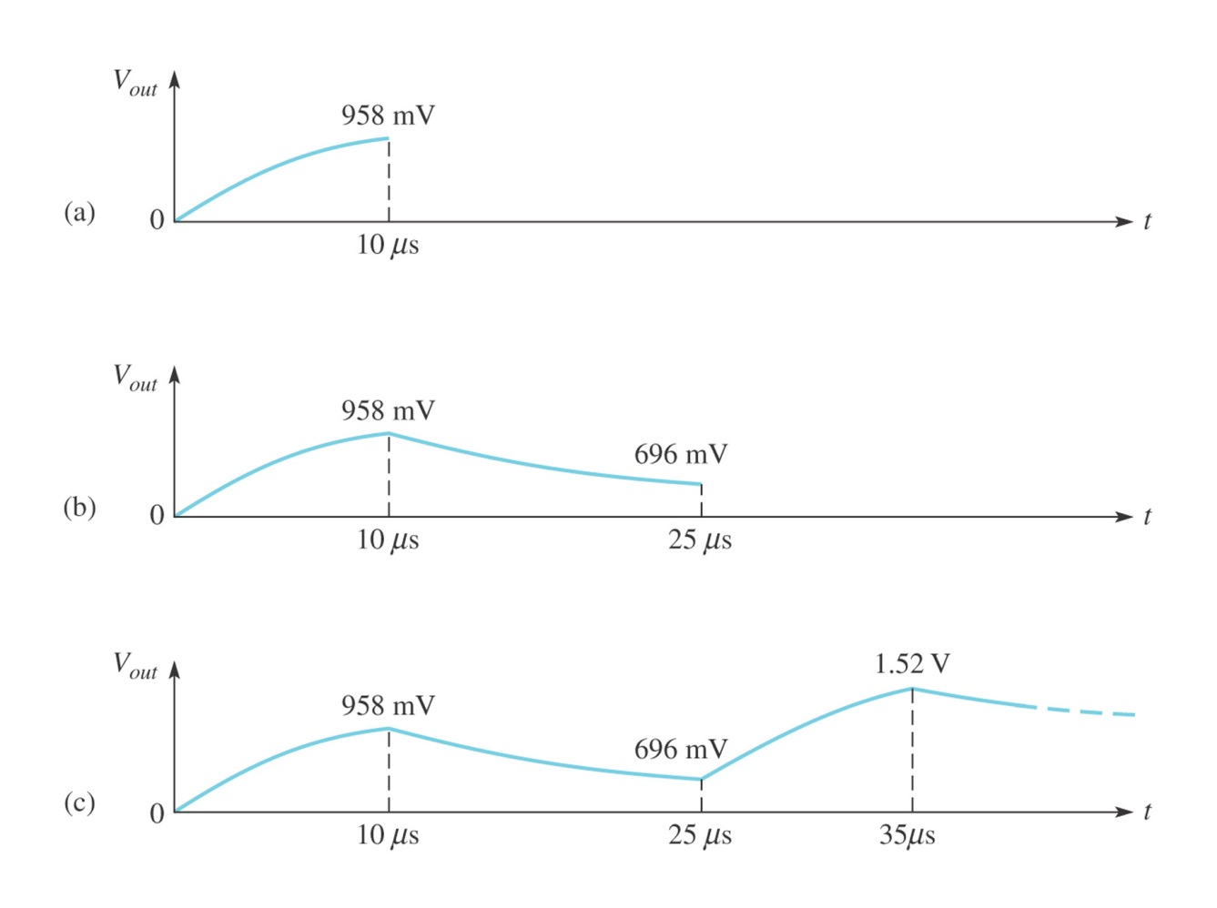
Solution

Slide 22
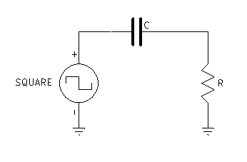
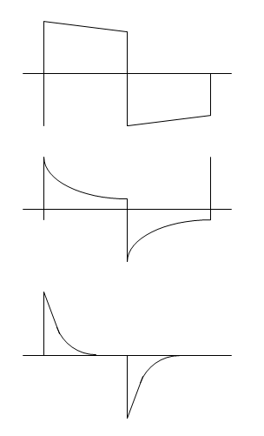
Differentiating Circuits
In this circuit, the output is taken across the resistor.
The shape of the output wave is dependent on the RC time constant, and the PW. The output is the differential of the input.
If the is much greater than the PW (10PW) the capacitor charges to very little of the input voltage.
If the is equal to the PW then the capacitor charges to 63.2% of the input voltage.
If the is much smaller than the PW (0.01*PW) then the capacitor charges very rapidly. The result is positive and negative spikes at the leading and lagging edges.

Slide 23
The RC Differentiator
An RC differentiator is a circuit that approximates the mathematical process of differentiation. Differentiation is a process that finds the rate of change, and a basic differentiator can produce an output that is the rate of change of the input.
C
A differentiating circuit takes the output
across the resistor.
V_{S}
R
V_{out}

Slide 24
The RC Differentiator
When a pulse generator is connected to the input of an RC differentiator, the capacitor appears as an instantaneous short to the rising edge and passes it to the resistor.
V_{C} = 0
The capacitor looks like a short to the rising edge because voltage across C cannot change instantaneously.
During this first instant, the output follows the input.

Slide 25
The RC Differentiator
After the initial edge has passed, the capacitor charges and the output voltage decreases exponentially.
The voltage across C is the traditional charging waveform.
The output decreases as the pulse levels off.

Slide 26
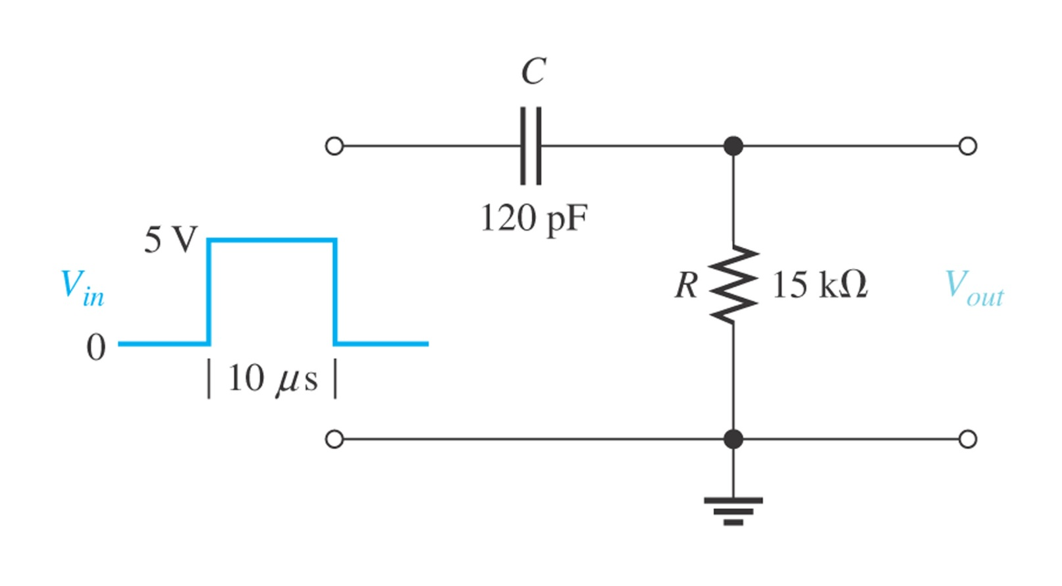
Example

Slide 27
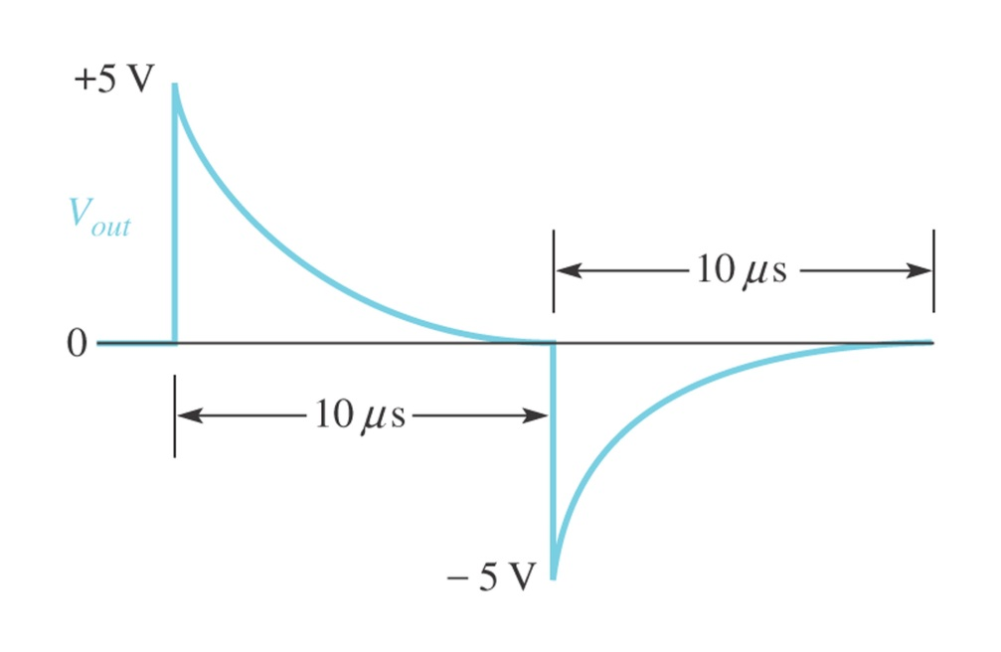
Solution
1. Time constant
2. Pw is bigger than 5 time constant 9.0

Slide 28
The RC Differentiator
The falling edge is a rapid change, so it is passed to the output because the capacitor voltage cannot change instantaneously. The type of response shown happens when t is much less than the pulse width (t<< tw).
The voltage across C when the input goes low decreases exponentially.
After dropping to a negative value, the output voltage increases exponentially as the capacitor discharges.

Slide 29
The RC Differentiator
The output shape is dependent on the ratio of t to tw.
V_{in}
t_{w}
5τ = t_{w}
When 5t = tw, the pulse has just returned to the baseline when it repeats.
5τ >> t_{w}
If t is long compared to the pulse width, the output does have time to return to the original baseline before the pulse ends. The resulting output looks like a pulse with “droop”.

Slide 30
The RL Integrator
Like the RC integrator, an RL integrator is a circuit that approximates the mathematical process of integration. Under equivalent conditions, the waveforms look like the RC integrator. For an RL circuit, t = L/R.
L
A basic RL integrator circuit is a resistor in series with an inductor and the source. The output is taken across the resistor.
V_{S}
R
V_{out}
What is the time constant if R = 22 kW and L = 22 mH?
1.0 ms

Slide 31
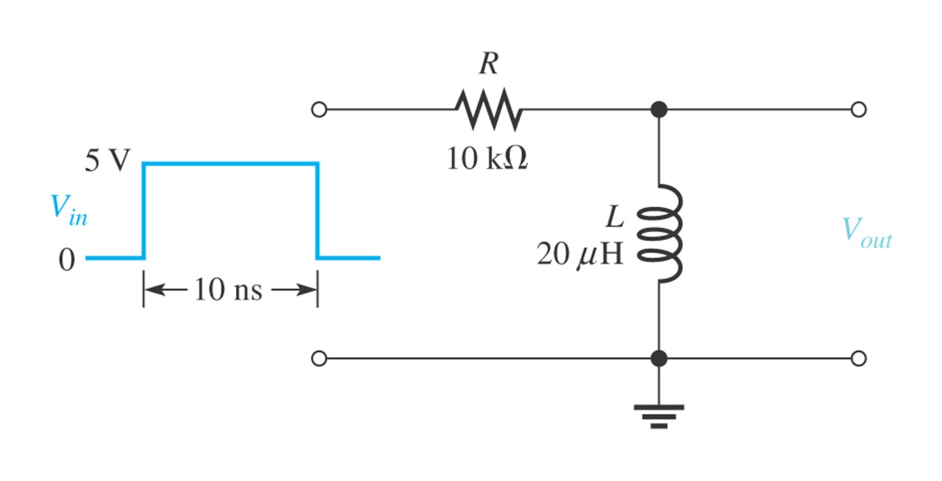
Example

Slide 32
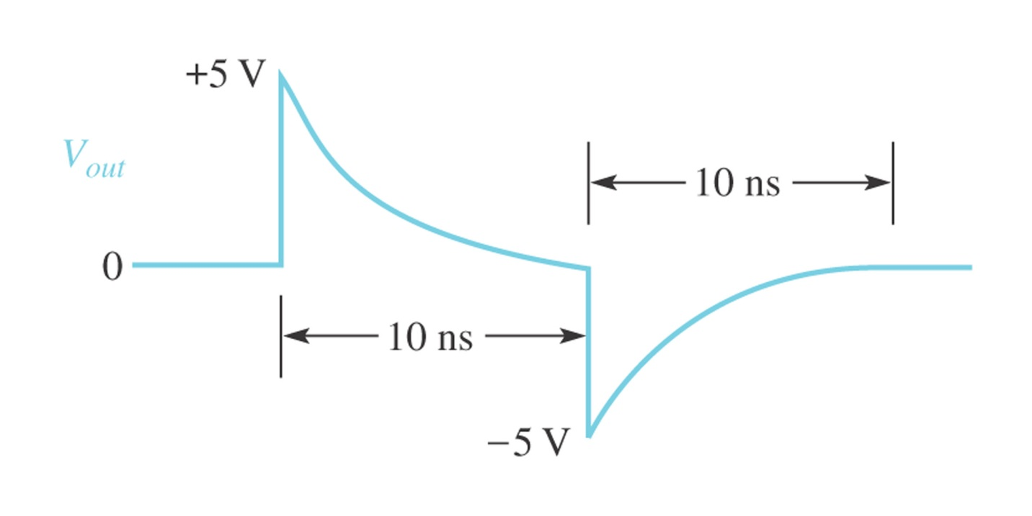
Solution
1. Time constant

Slide 33
The RL Integrator
When the pulse generator output goes high, a voltage immediately appears across the inductor in accordance with Lenz’s law. The instantaneous current is zero, so the resistor voltage is initially zero.
The induced voltage across L opposes the initial rise of the pulse.
L
V_{S}
+
−
The output is initially zero because there is no current.
R
0 V

Slide 34
The RL Integrator
At the top of the input pulse, the inductor voltage decreases exponentially and current increases. As a result, the voltage across the resistor increases exponentially. As in the case of the RC integrator, the output will be 63% of the final value in 1t.
The induced voltage across L decreases.
L
V_{S}
+
−
The output voltage increases as current builds in the circuit.
R

Slide 35
The RL Integrator
When the pulse goes low, a reverse voltage is induced across L opposing the change. The inductor voltage initially is a negative voltage that is equal and opposite to the generator; then it exponentially increases.
The induced voltage across L initially opposes the change in the source voltage.
L
The output voltage decreases as the magnetic field around L collapses.
V_{S}
−
+
R
Note that these waveforms were the same in the RC integrator.

Slide 36
The RL Differentiator
An RL differentiator is also a circuit that approximates the mathematical process of differentiation. It can produce an output that is the rate of change of the input under certain conditions.
R
A basic RL differentiator circuit is an inductor in series with a resistor and the source. The output is taken across the inductor.
V_{S}
L
V_{out}

Slide 37
The RL Differentiator
When a pulse generator is connected to the input of an RL differentiator, the inductor has a voltage induced across it that opposes the source; initially, no current is in the circuit.
V_{R} = 0
Current is initially zero, so VR= 0.
During this first instant, the inductor develops a voltage equal and opposite to the source voltage.
R
V_{S}
+
L
−

Slide 38
The RL Differentiator
After the initial edge has passed, current increases in the circuit. Eventually, the current reaches a steady state value given by Ohm’s law.
The voltage across R increases as current increases.
R
V_{S}
The output decreases as the pulse levels off.
+
L
−

Slide 39
The RL Differentiator
Next, the falling edge of the pulse causes a (negative) voltage to be induced across the inductor that opposes the change. The current decreases as the magnetic field collapses.
The voltage across R decreases as current decreases.
R
−
V_{S}
L
The output decreases initially and then increases exponentially.
+

Slide 40
The RL Differentiator
As in the case of the RC differentiator, the output shape is dependent on the ratio of t to PW
V_{in}
_{Pw}
When 5t = tw, the pulse has just returned to the baseline when it repeats.
5τ = P_{w}
If t is long compared to the pulse width, the output looks like a pulse with “droop”.
5τ >> P_{w}

Slide 41
Application
An application of an integrator is to generate a time delay. The voltage at B rises as the capacitor charges until the threshold circuit detects that the capacitor has reached a predetermined level.
SW closes
V_{in}
A
R
B
V_{out}
V_{A}
Threshold circuit
SW
C
V_{B}
Threshold
V_{out}
Time delay

Slide 42

Selected Key Terms
Integrator
Time constant
Transient time
A circuit producing an output that approaches the mathematical integral of the input.
A fixed time interval, set by R and C, or R and L values, that determines the time response of a circuit.
An interval equal to approximately five time constants.

Slide 43
Selected Key Terms
Steady state
Differentiator
The equilibrium condition of a circuit that occurs after an initial transient time.
A circuit producing an output that approaches the mathematical derivative of the input.

